Slide 1



Team Management Software Project Plan
Pablo Almarza
Miguel Arnaiz
Xiao Fernández
Carlos García
Samai García
Group 2391
Team 5
Cantoblanco, Madrid 27/05/2021
Notes:
Good Morning everyone, we are T5 and we will explain our project plan, that has been developed for Docufy, the Team Management Software (~10 secs)

Slide 2
CONTENT
Introduction
Project Definition
Project Estimation
Project Planning
Project Monitoring and Control Procedure
General reflection aspects
Specific reflection aspects
Conclusions
Notes:
Describe the content (~10 secs)
Content: Miguel
Introduction: Miguel
Project Definition: Miguel
Project Estimation: Samai
Project Planning: Pablo
Project Monitoring and Control Procedure: Xiao
General reflection aspects: Carlos
Specific reflection aspects: Carlos
Individual contribution: todos
Conclusions: Miguel

Slide 3
INTRODUCTION
Project Definition
Project Estimation
Project Planning
Project Monitoring and Control Procedure
Notes:
First of all, we will start by giving the definition of our project, then we will continue with the Project Estimation and, after that, the project planning,which includes the cost, the personnel and the Gantt chart to take a look at how long it will take us to finish the project (and the iterations that we will go through). Finally, we will explain the project monitoring and control procedure that we decided to use.(25-30 sec)

Slide 4

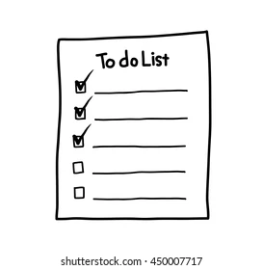
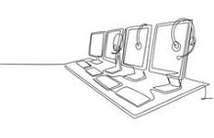

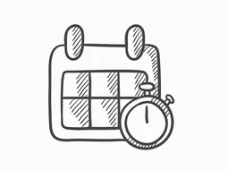
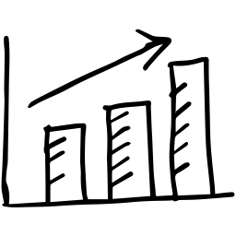
PROJECT DEFINITION: OBJECTIVES
Create teams
Plan meetings
Track objectives
Schedule
Deliver files
Statistics tracking
Notes:
The main objectives of Docufy will be:
For the eps students:
Create teams for the different assignment
Have a calendar with pending and complete meetings and with the deadlines for the assignments
Be able to plan meetings.
Track objectives of meetings
The system must:
Deliver the assignments automatically.
For professors:
Have statistics available about the meetings and assignments
(25-30 secs)

Slide 5
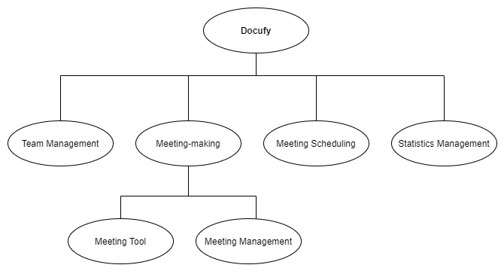
PROJECT DEFINITION: SUBSYSTEMS
Notes:
Docufy will be divided into six subsystems, this will facilitate the implementation and
modulate the functionalities.
Team management subsystem: Create teams
Meeting-making subsystem: It includes meeting tool and meeting management subsystems.
Meeting tool subsystem: Track objectives
Meeting management subsystem: Everything related with the administration of meetings
Meeting scheduling subsystem: We can see pending or completed teamwork meetings.
Statistics management subsystem: Provides the statistics for the professors of meetings and teams.
(1min)

Slide 6
PROJECT ESTIMATION AND PLANNING
Complexity factors
Subsystems
Personnel assignation
Gantt chart
Material resources
Human resources
Cost of each increment
Notes:
Describe the project estimation(~10 secs)

Slide 7
PROJECT ESTIMATION
Function Point estimation: Measure software size based on user-meaningful functions.
Value adjustment factor:
Based on 14 general characteristics of the system.
AF = (TDI x 0,01) + 0,65 = 0,92
Complexity Factors | TDI
Data Communications | 5
Distributed Data Processing | 4
Performance | 4
Heavily Used Configuration | 2
Transaction Rate | 0
Online Data Entry | 5
End-User Efficiency | 3
On-line Update | 4
Complex Processing | 0
Reusability | 0
Installation Ease | 0
Operational Ease | 0
Multiple Sites | 0
Facilitate Change | 0
TOTAL | 27,0
Notes:
To estimate the cost of the project, we used the function point estimation technique, that measures the software size based on user-meaningful functions. The value of the adjustment factor is based on 14 general characteristics of the system, that rate the general functionality of the application being counted. The most complex characteristics were the data communications, as the applications needs more than one front end computers, and online data entry, as more than 30% of the inputs are interactive.
We also considered important the data processing and performance, as three-tier architecture of the application requires communication in both directions and a special design that provides an appropriate visualization of the web application interface on any device.
(1 minute)

Slide 8
PROJECT ESTIMATION
Subsystem | Adjusted FP | Effort (person-day) | Duration in days | Code Lines | Documentation pages
Team management | 83,72 | 33,36 | 100 | 2427,88 | 41,86
Meeting scheduling | 12,88 | 5,13 | 41 | 373,52 | 6,44
Meeting management | 125,12 | 49,86 | 184 | 3628,48 | 62,56
Meeting tool | 19,32 | 7,7 | 21 | 560,28 | 9,66
Statics management | 34,96 | 13,93 | 59 | 1013,84 | 17,48
TOTAL | 276 | 109,98 | 405 | 8004 | 138
Notes:
After collecting and processing all the data about the system, we obtained this table. We can see that the greatest subsystem is the Meeting Management while the smallest one is the Meeting Scheduling subsystem. The estimated duration of the project is of 405 days, and it will require approximately 8004 lines of code and 138 documentation pages.
(30 seconds)
LOC = 29 * AFP (Average number of source instructions per function point Object oriented Language, Unit 4, page 47)
Documentation pages = 0,5 per AFP ( PDF of Practical Assignment 2, C.2.Statistical Parameters)

Slide 9
PROJECT PLANNING
Activity Performed | Personal Assignation
Requirements Analysis | Systems Analyst Designers
Design | Designers
Coding and Unit Tests | Systems Analyst Designers
Integration Tests | Systems Analyst Designers
Installation | Systems Analyst Systems Technician
Notes:
The project will be developed according to a software life cycle model of “incremental and iterative” type, using the following phases at each increment: requirements analysis, design, coding and unit tests, integration tests and installation. The working calendar to be considered is from Monday to Friday, with 40 business hours and 22 working days/person-month.

Slide 10
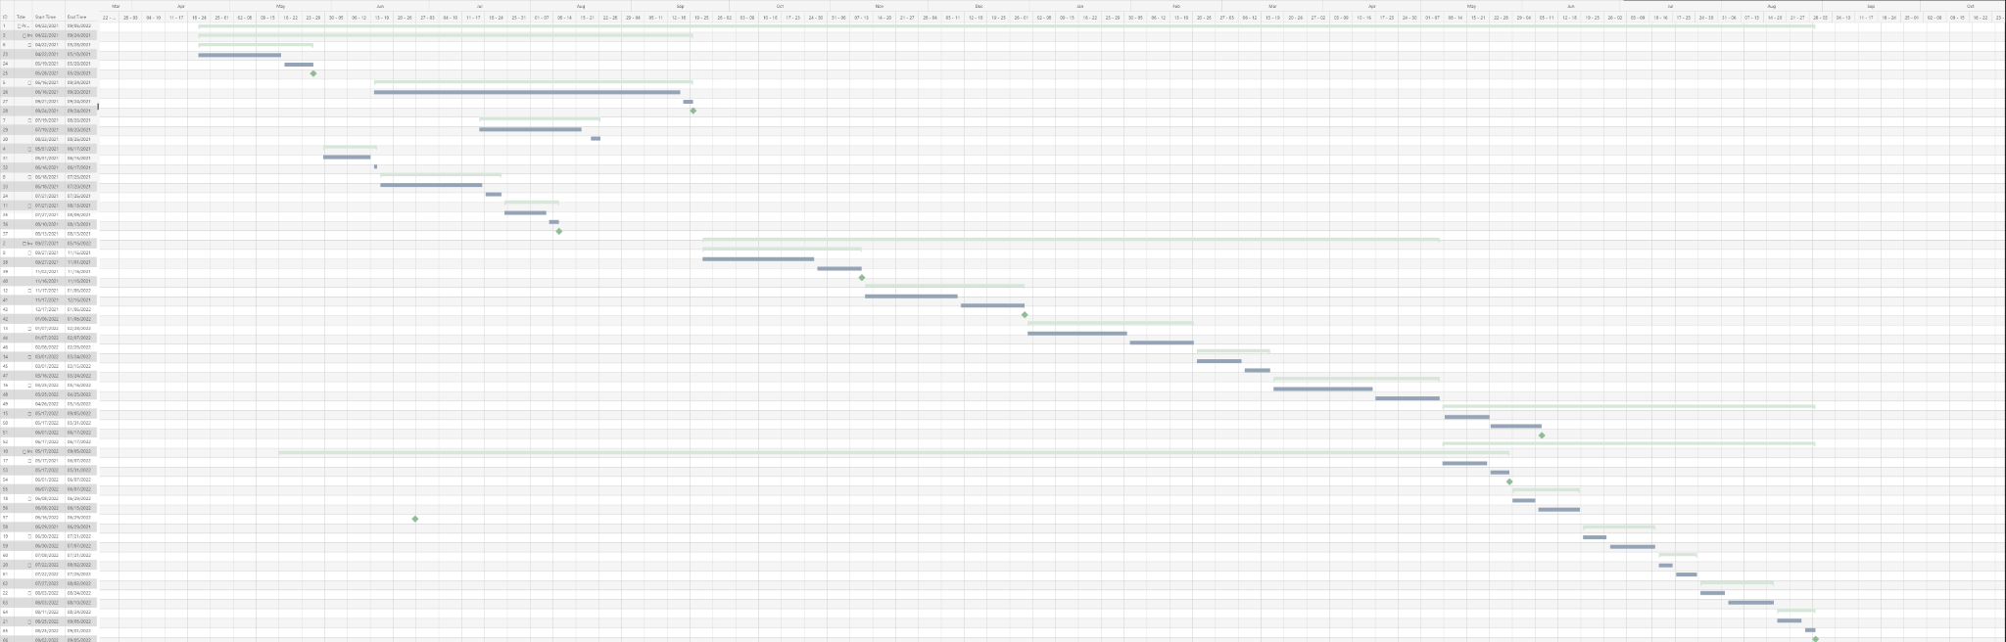
PROJECT PLANNING
Notes:
Show the Gantt Diagram (~10secs)

Slide 11
PROJECT PLANNING
Material | Cost | Amount | Total
Equipment (HW/SW costs) | 1.050€/month | 405 days | 19.330€
Development Workstation | 1.650€ | 3 | 4.950€
Performance Workstation | 3.200€ | 1 | 3.200€
Integrated development environment | 1.100€ | 1 | 1.100€
 |  | TOTAL | 28.580€
Notes:
Equipment: (€ 1.050 / 22) x (405) days = € 19.330
Material Resources Cost = € 19.330 (Equipment) + € 1.650 (Development) x 3 + € 3.200 (Performance) + € 1.100 (Integrated) = €28.580
During the project, Hardware Resources and Development Software will be financed. The cost for both hardware and software is 1,050 euros/month. In addition, different workstations should be acquired.
So the cost of both the equipment and material resources amounts to €28.580

Slide 12
PROJECT PLANNING
Employee | Cost | Working days | Amount | Total
System analyst | 400 €/day | 264 | 1 | 105.600€
“Senior” designer | 350€/day | 284 | 1 | 99.400€
“Junior” designer | 200€/day | 284 | 2 | 113.600€
System technician | 300€/day | 40 | 1 | 12.000€
Project manager | 400€/day | 405 | 1 | 162.000€
 |  |  | TOTAL | 492.600€
Notes:
1 system analyst 400 euros/day.
1 “senior” designer 350 euros/day.
2 “junior” designers 200 euros/day.
1 systems technician 300 euros/day.
1 project manager 400 euros/day

Slide 13
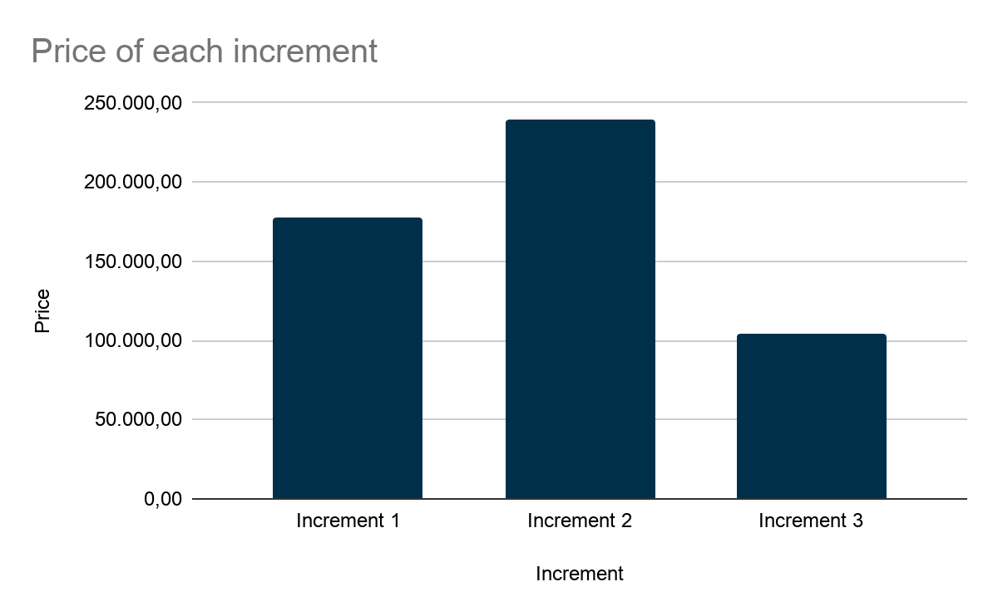
PROJECT PLANNING
Increment | Price
Increment 1 | 177.201,2
Increment 2 | 239.742,8
Increment 3 | 104.236
TOTAL | 521.180€
Notes:
Summing all the costs involved, taking account the material resources and the qualified personnel, the total estimated cost for the project is 521.180€. The cost of each increment will be: for increment one 177.201,2€. For increment two 239.742,8€. For increment three 104.236€

Slide 14
PROJECT PLANNING
Quality Management Plan
Risk Management Plan
Acquisitions Management Plan
Documentation Management Plan
Notes:
In addition, important documents have being developed such as the Quality Management Plan, Risk Management Plan, Acquisitions Management Plan and documentation, in order to assure the quality of the project, prevent risks, and having a detailed description of the development of the project.

Slide 15
PROJECT MONITORING AND CONTROL PROCEDURE
Configuration Management.
Progress Monitorization.
Verifications at each Phase.
Testing and Validation.

Slide 16

PROJECT MONITORING AND CONTROL PROCEDURE
Configuration Management
System and software requirements
Design documentation about the project
Databases and the verification by the user.
Notes:
The configuration management of Docufy will be the system and software requirements (described in the requirements section), the design documentation about the project and the databases and the verification by the user.
If any configuration of these files’ changes, the project will need to be reviewed and introduce those new changes to adjust the new management configuration
These changes will also be quoted in the plan and configuration of the project as well as in the history of versions of the project document.

Slide 17
PROJECT MONITORING AND CONTROL PROCEDURE
Phases | Analyst | Designers | Technical Staff | Documentation
Requirement Analysis | x | x |  | DOCUFY-ARQ
Design |  | x |  | DOCUFY-DES
Coding and Unit Testing | x | x |  | Code
Integration Testing |  | x |  | DOCUFY-TST
Installation | x |  | x | DOCUFY-UM DOCUFY-TM
Notes:
Here we can see the monitoring of the increments,
Each meeting will be between the responsible for each phase and the project leader.
We can see in which phase each worker is involved.
We also represented the control of the verifications at each phase.
For the analysis requirements phase, we will get the DOCUFY-ARQ file, a revision that consist of validating the requirements with the purpose of correcting and completing those requirements, the revision will also look for repeated requirements and inconsistencies.
For the design phase we get the DOCUFY-DES file, the verification will check that the design chosen is the one that maximizes the cohesion and minimizes the coupling of the application. This verification will also check the flexibility and reusability of the software.
In the phase of the integration tests, we will make unitary tests and integration tests. Described in the next section.
In the last part, we will develop a technical manual (DOCUFY-TM) and a user manual (DOCUFY-UM). In this phase we will revise these two files, checking that they have the important and relevant information.
After each increment there will be a reunion with the client to show him how the project is going
Increment 1: 29 of May of 2021
Increment 2: 17 November of 2021
Increment 3: 08 June of 2022
When the third increment is done, there will be a reunion with all the team and the client. In this reunion the client will test the application.

Slide 18
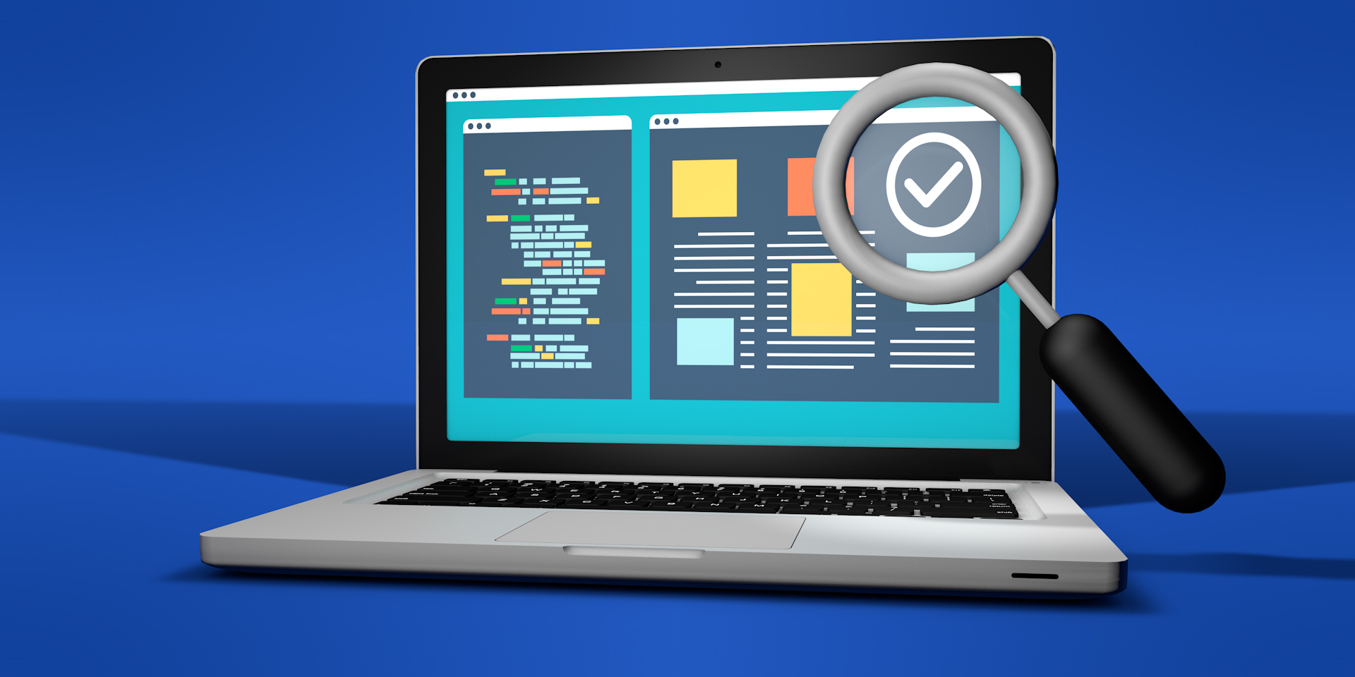
PROJECT MONITORING AND CONTROL PROCEDURE
Testing and Validation
Unitary tests: black-box and white-box tests
Integration tests
Validation tests
Acceptance tests
Notes:
With the objective of finding errors in our project we will make unitary tests for each module. We will use black-box testing for every module and white-box tests on the modules we think that are more complex and relevant for the project.
After these tests, we will start with the integration tests. For each set of integrated modules, we will use the type we decide in the design phase of each one: descendant, ascendant or sandwich.
As the project must follow non-functional requirements of security, resources, performance, and support, we will also make tests to certify they all work properly.
If all those tests pass and all the increments are done, validation tests of the final product will be done. These tests are carried out by the user and the system analyst. Then, all the requirements will be checked.
Finally, the project leader will tell the user to take the acceptance tests. For these tests, the client will check if the software is the one he/she was looking for.

Slide 19

GENERAL REFLECTION ASPECTS
Difficulties encountered
Improvable aspects
Acquired knowledge
Cohesion and teamwork
Notes:
Difficulties encountered:
During the creation process of this project, we faced multiple difficulties, most notably regarding the requirements, identifying and displaying them correcetly in order to calculate the function points and work days.
Other difficulty that we faced is, when organising the project plan document we had a hard time coordinating our efforts as a team to complete the document and not have to redo every part a thousand times.
Improvable aspects:
The two big aspects that can always be improved, and we are no exception, are time management and team cooperation. Most of our problems could have been avoided with these two aspects.
With a better time management, we could have managed to have more time to fix mistakes and, with better comunication and coordination, we could have avoided unnecessary repetition of tasks when something else related was done incorrectly.
Acquired knowledge:
The biggest most important block of knowledge obtained during this project would be documentation. Documenting everything that is being done, that needs to be done, the cost of your work, etc.
Other important aspects we learnt about are how to analyse and define the project, find the best solution for it and estimating the cost of making said project.
Cohesion and teamwork:
Teamwork has been a huge part for the successful completion of this project, I am confident that we are now a far better team than when we started.
We have grown as a team and by the end of the project we were on the same page, working and communicating better than ever, dividing the tasks into smaller ones and coordinating them so we can end up with a cohesive project.

Slide 20
SPECIFIC REFLECTION ASPECTS
Quality of the planned project (adaptation, completeness, and coherence between the different parts of the Project Plan).
Procedure carried out to develop the Project Plan
Team Management
Individual contribution
Notes:
Quality of the planned project (adaptation, completeness, and coherence between the different parts of the Project Plan):
The week preceding the deadline we reviewed and corrected the project checking if there is cohesion between all the parts, grammar errors or if we left something undone.
Procedure carried out to develop the Project Plan:
During the project we had two meetings every week. In these meetings we checked the progress of the tasks we had been assigned, and assigned new tasks for the next week.
Team Management:
We also divided the work between the members, leaving each aspect to one person so there were no conflicts when completing it.
Now we will explain how we divided the work: .........
Carlos: I mostly helped with the requirements identification and subsystem estimation as well as checking the grammar and cohesion of the project
Pablo: Contributed to the quality of the planned project by ensuring of having everything complete before moving forward.
Xiao: I oversaw the solutions to employ and the monitoring and control, as well as checking all the document was correct in terms of format and correlation. I also tried to distribute the work equitably.
Samai: I helped to organise and divide the different tasks in an equitable way, and make sure to carry out my work the best possible. I was in charge of estimating the days and cost of the project based on the FP. I also try to solve the doubts of the team by asking the teacher for help when needed.
Miguel: I helped calculating the function points for each subsystem and defining functional requirements

Slide 21
CONCLUSIONS
Working days: 405
Cost: € 521.180
Notes:
To conclude, we calculated we need a total of 405 days to develop the project.
Also the cost of the project amounts to €521.180 if there is no difficulties.

